Slide 1
CSEN 602
Project Presentation
Done by: Team 92

Slide 2
Raneem M1
Give an overview of your team’s implementation, How you implemented the OS and processes?
(Screenshots and voiceover in the next slide)

Slide 3

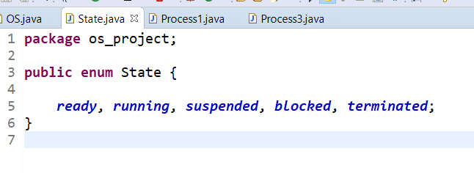
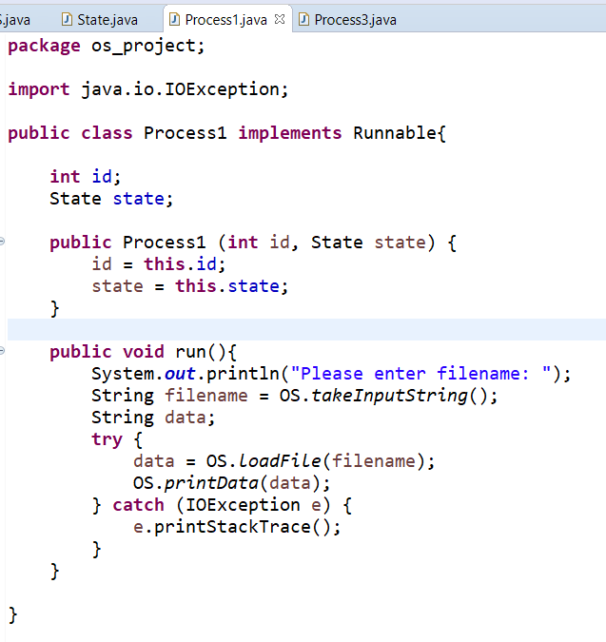
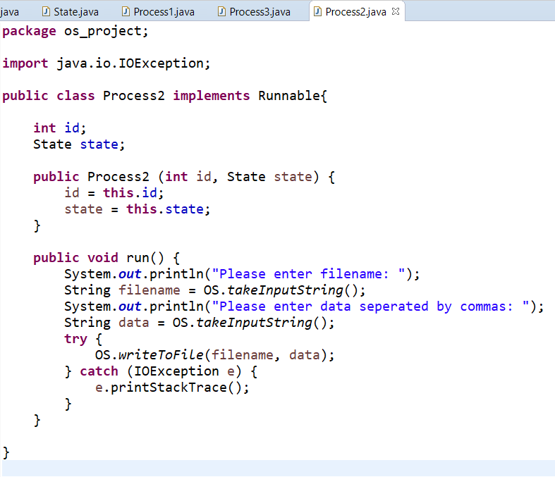
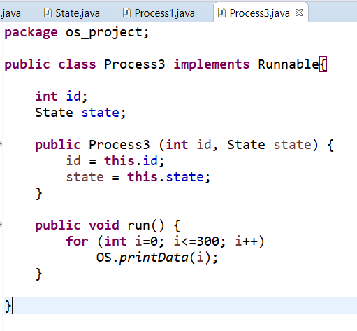

Slide 4
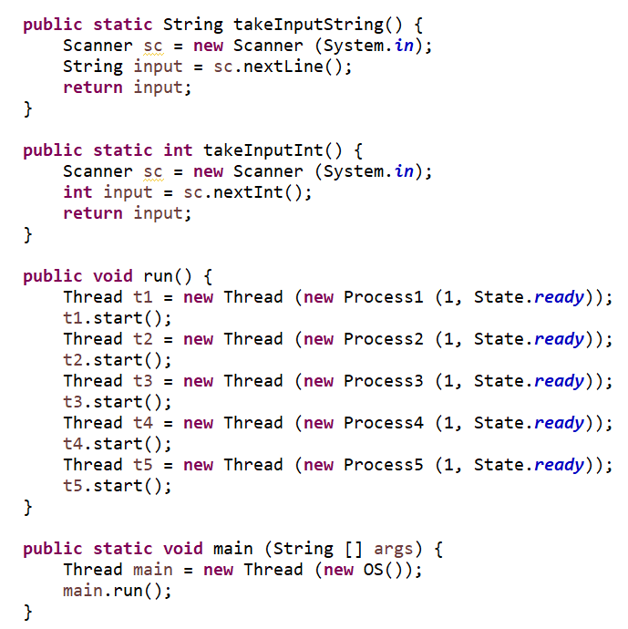
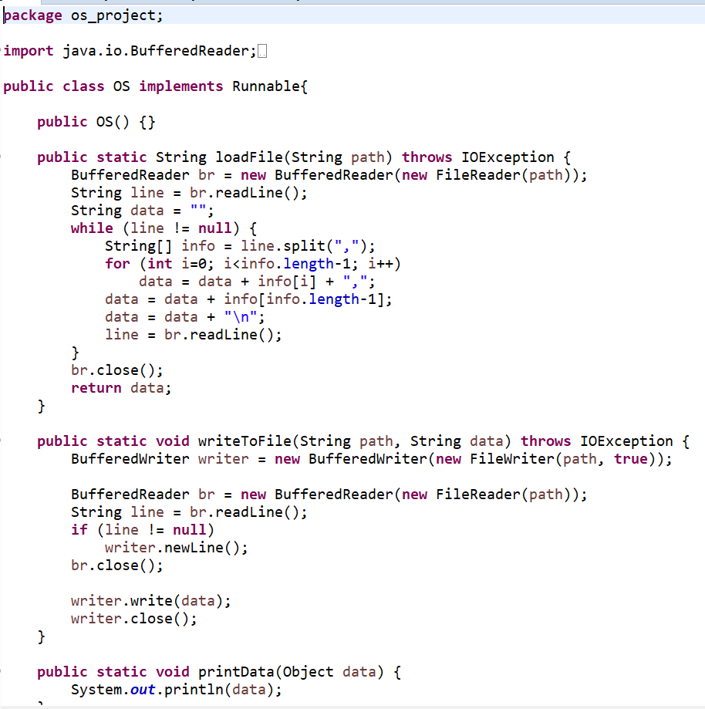

Slide 5
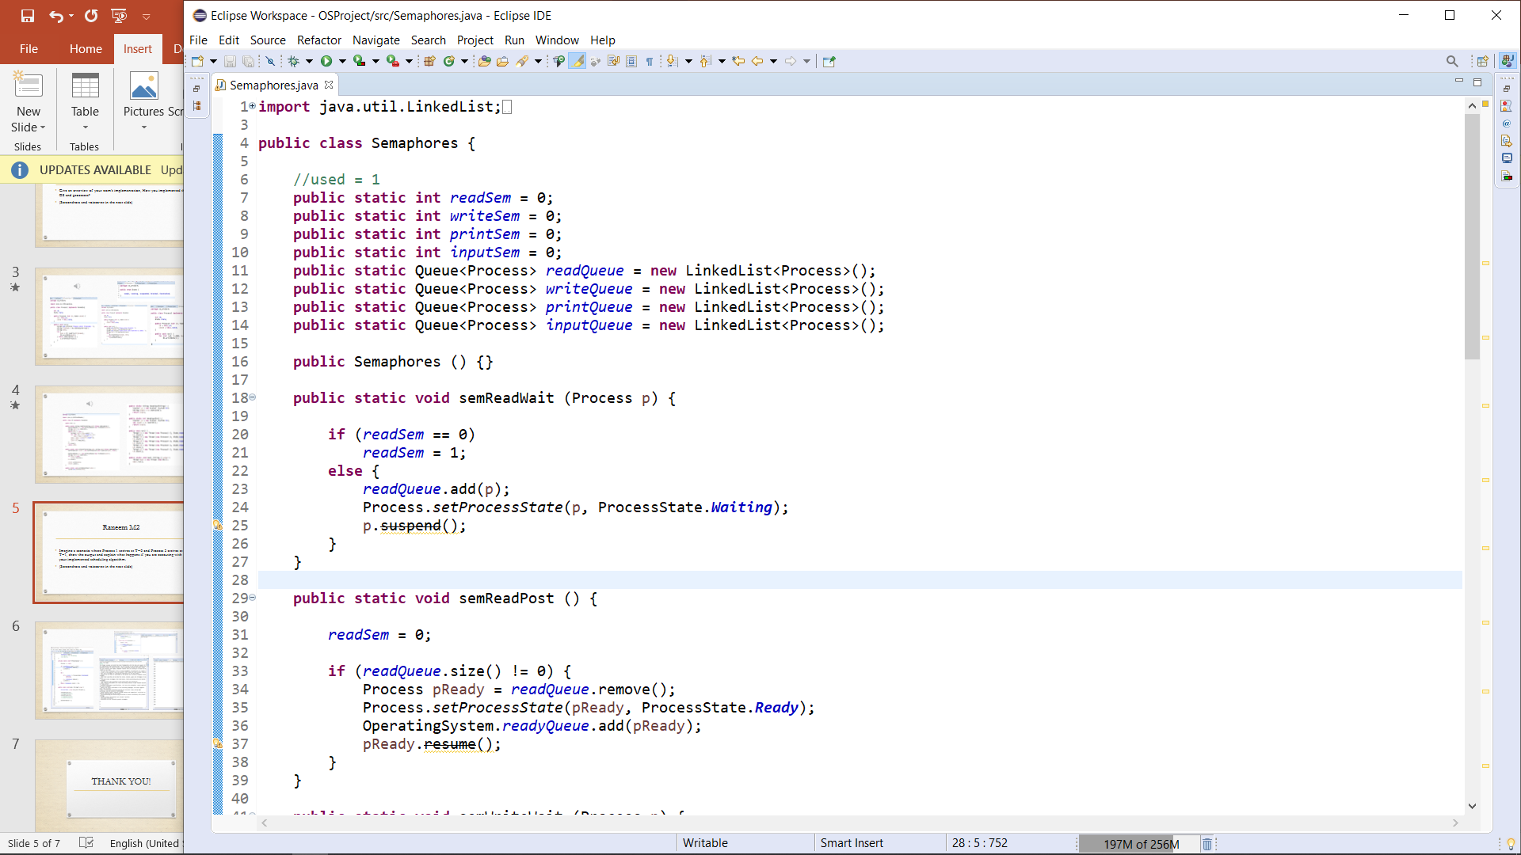
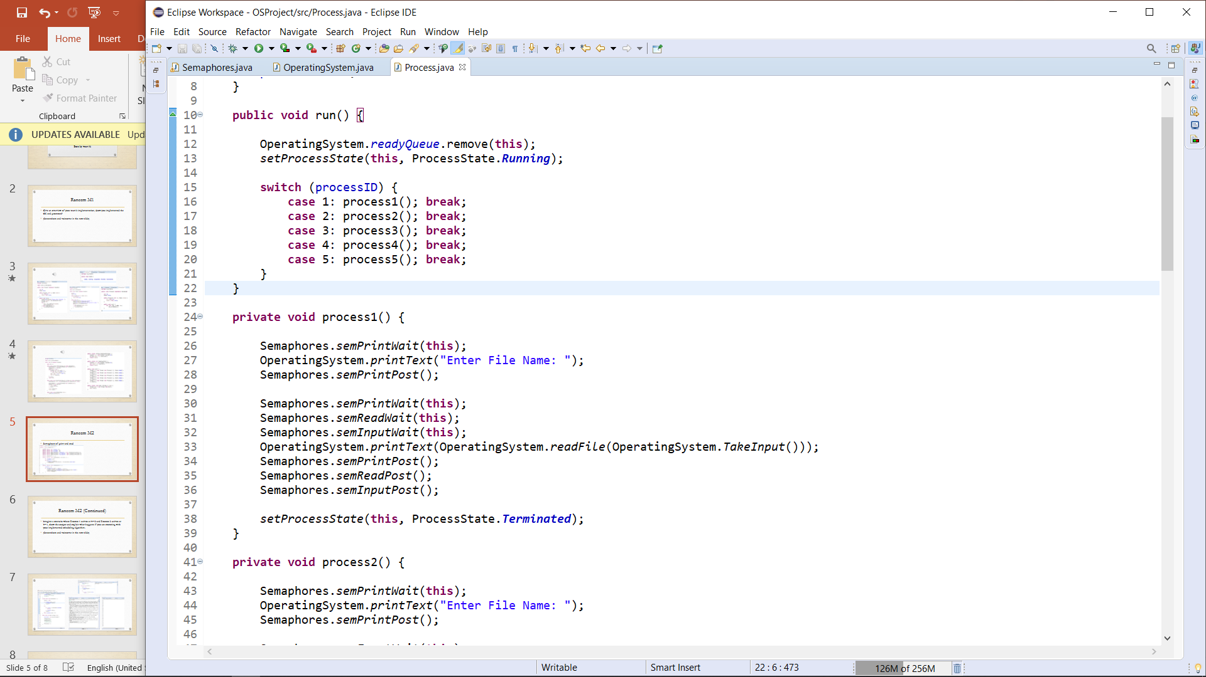
Raneem M2
Semaphore of print and read

Slide 6
Raneem M2 (Continued)
Imagine a scenario where Process 1 arrives at T=0 and Process 3 arrives at T=1, show the output and explain what happens if you are executing with your implemented scheduling algorithm.
(Screenshots and voiceover in the next slide)

Slide 7
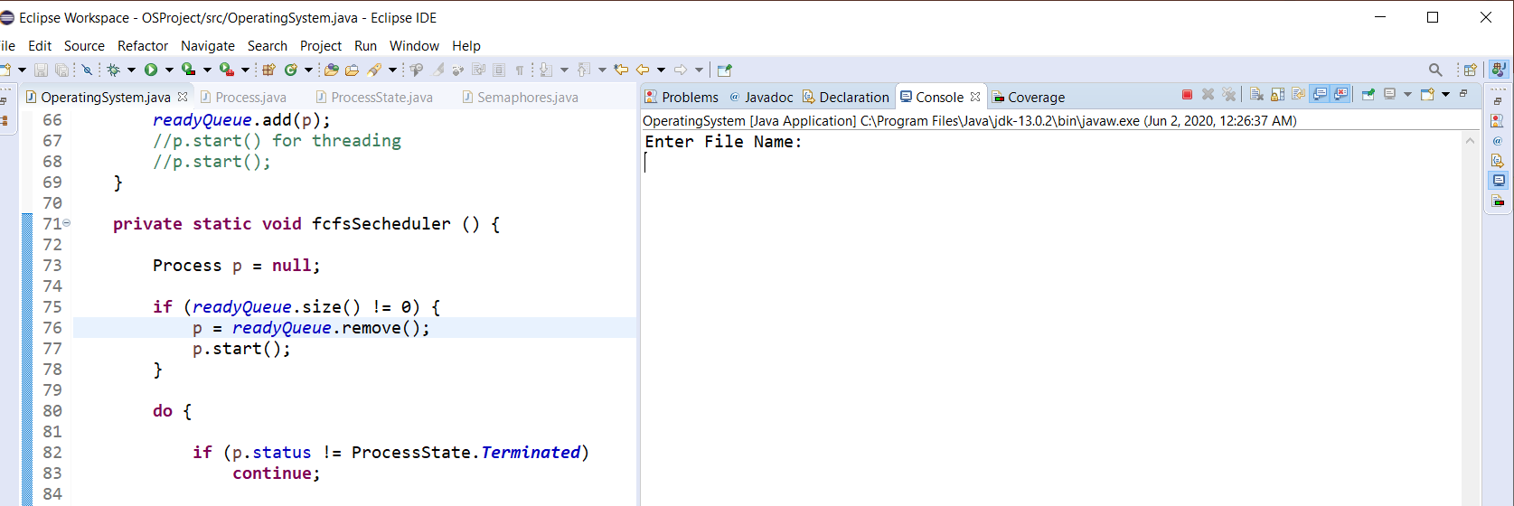
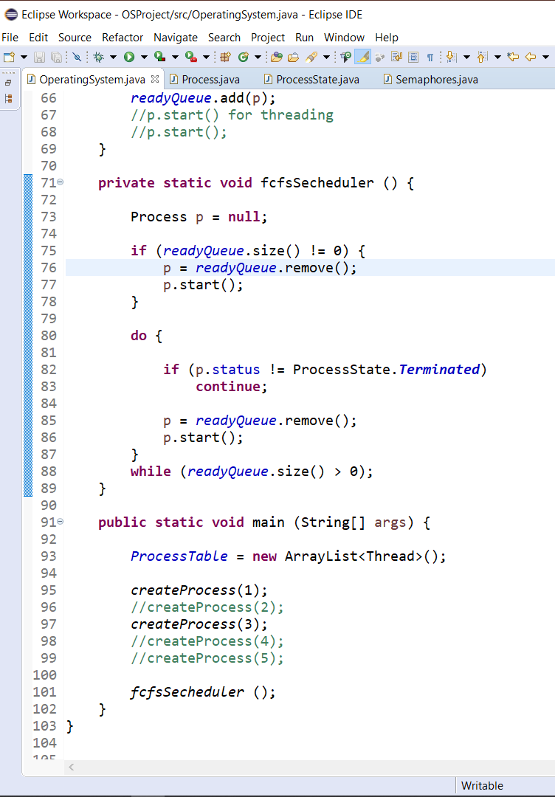
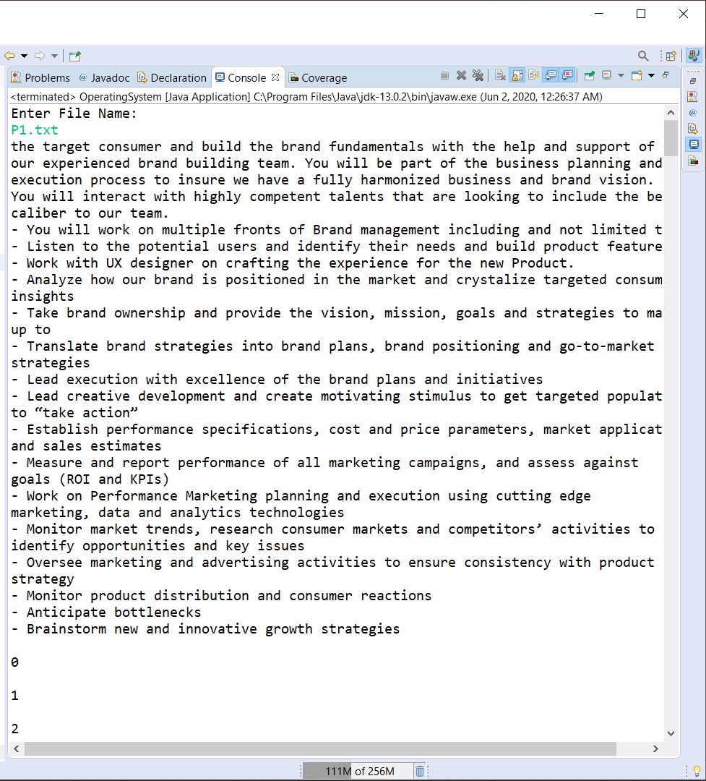
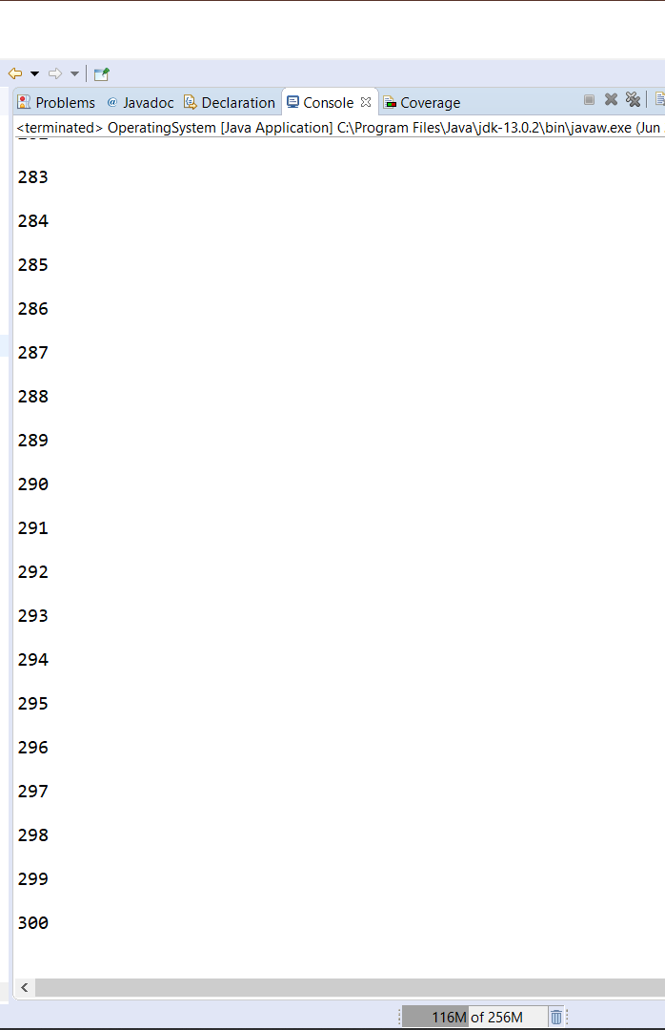

Slide 8
Abdelrahman M1
Give an overview of your team’s implementation, How you implemented the OS and processes?
(Screenshots and voiceover in the next slide)

Slide 10
Abdelrahman M2
Semaphore of writing and taking input
Imagine a scenario where Process 1 arrives at T=0 and Process 3 arrives at T=1, show the output and explain what happens if you are executing with your implemented scheduling algorithm.
(Screenshots and voiceover in the next slide)

Slide 12
Mohamed Yasser M1
Give an overview of your team’s implementation, How you implemented the OS and processes?
(Screenshots and voiceover in the next slide)

Slide 14
Mohamed Yasser M2
Scheduling algorithm
Imagine a scenario where Process 1 arrives at T=0 and Process 3 arrives at T=1, show the output and explain what happens if you are executing with your implemented scheduling algorithm.
(Screenshots and voiceover in the next slide)

Slide 15
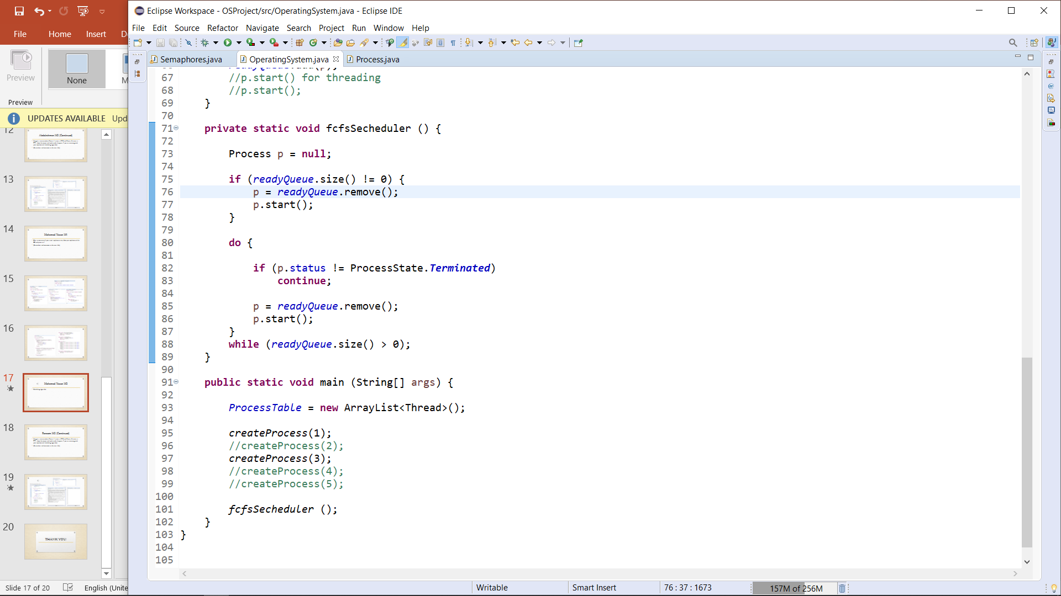

Slide 16
THANK YOU!

